Slide 1
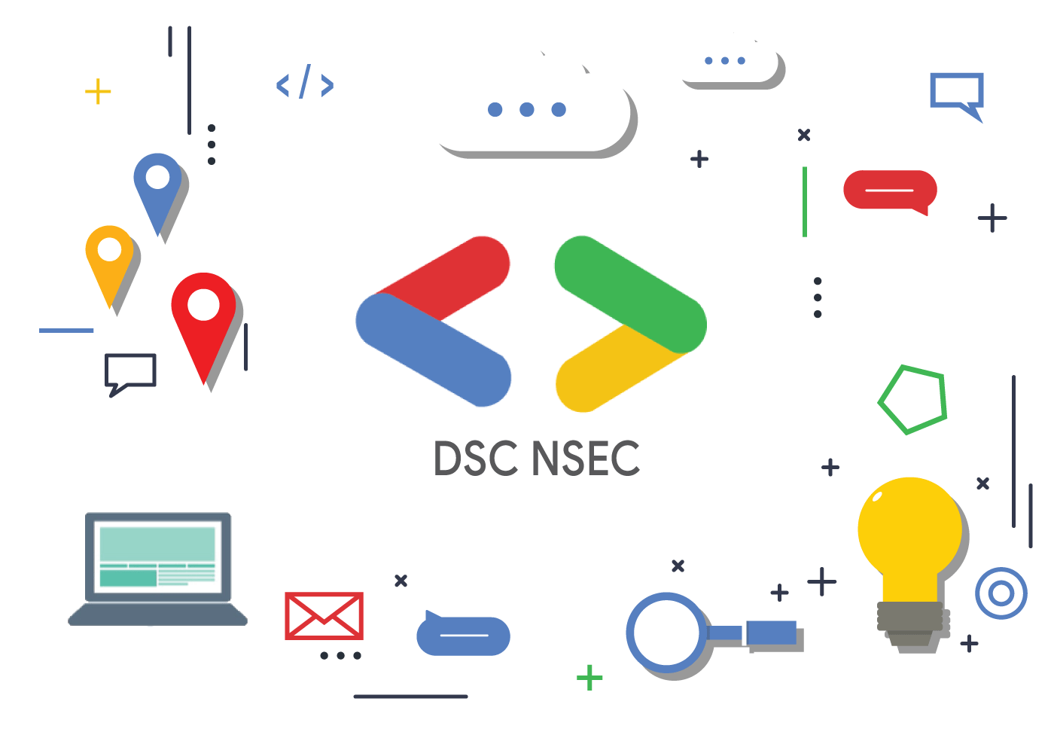
DSC AKGEC

Slide 2
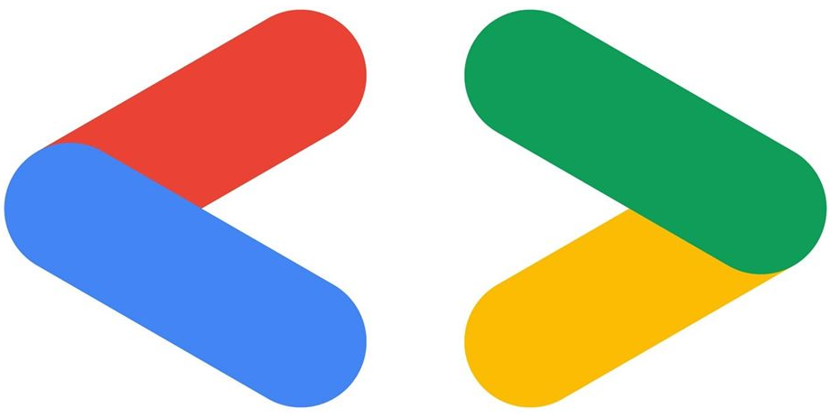
What is DSC ?
Helping students bridge the gap between theory and practice
Developer Student Club is an initiative taken by Google Developers.
When you join our
programs, you’re joining a community
By joining a DSC, students grow their knowledge in a peer-to-peer learning environment and build solutions for local businesses and their community.
Developer Student Club are university based community groups for students interested in Google developer technologies.

Slide 3
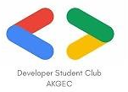
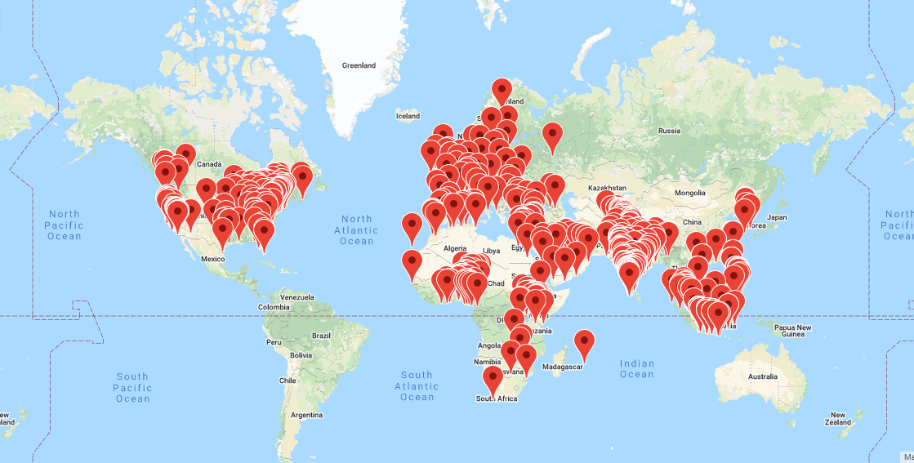
DSC GLOBAL
DSC covers 195 Countries and over 700 universities all over globe.

Slide 4
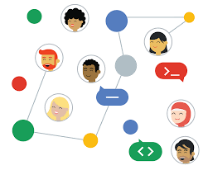

DSC AKGEC
DSC-AKGEC is divided into four core domains which include App development, Machine Learning, Web development and Managerial domains.
We have a core team of 32 developers in total who are being led under the guidance of Shikha Baliyan Ma’am (the faculty coordinator of DSC) and Rohan Asthana (4th year lead of DSC).
We are associated with TIFAC-core of our college.

Slide 5
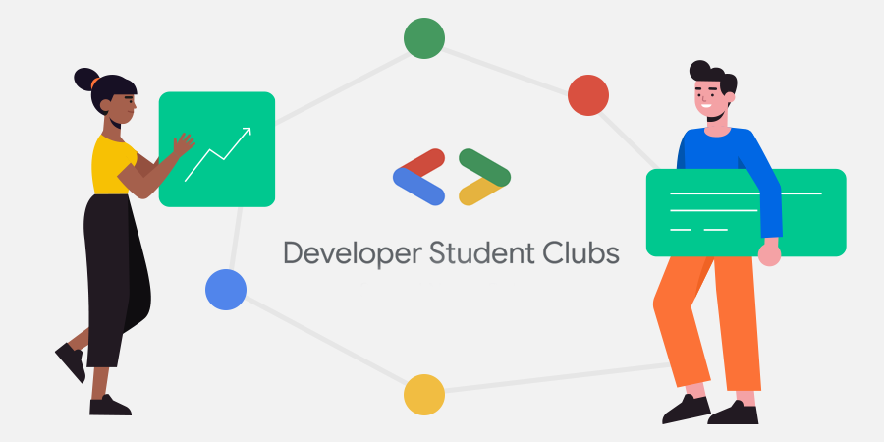

DSC-AKGEC Vision
Dsc Akgec focuses on nurturing students in such a way that they become ready to face the corporate world.
Specifically, aimed for university students to help them build their mobile, web, machine learning, cloud service skills.
Ample of opportunities are provided to the members of DSC that helps in enhancing their skills and at last, achieving their dream job.

